Slide 1
TAKING CHARGE!
NEGOTIATING THE DEAL YOU WANT
EVERY TIME
ROSS R. RECK, PhD
www.rossreck.com
602-391-3250

Slide 2
PROBLEMS WITH THE TRADITIONAL METHODS OF NEGOTIATION
Narrow in focus
Loose ends
Missing pieces
Static as opposed to dynamic
No operational model

Slide 3
NEGOTIATION HAS ITS ROOTS WITH
THE LATIN WORD
OTIO

Slide 4
THE LATIN WORD WHICH MEANS
THE OPPOSITE OF OTIO IS
NEGOTIO

Slide 5
CONCLUSIONS
• Negotiation simply means to conduct business
Negotiation is all about __________?

Slide 6
DEFINITION
Negotiation is a basic means of getting what you want from other people

Slide 7
OVERLOOKED FACTS ABOUT PEOPLE
They make decisions based on _________?
They are motivated by _________?
Successful negotiations must be _________?

Slide 8
HOW WIN-WIN NEGOTIATING WORKS
Trust occurs
Information is shared
The pie expands
Win-wins happen

Slide 9
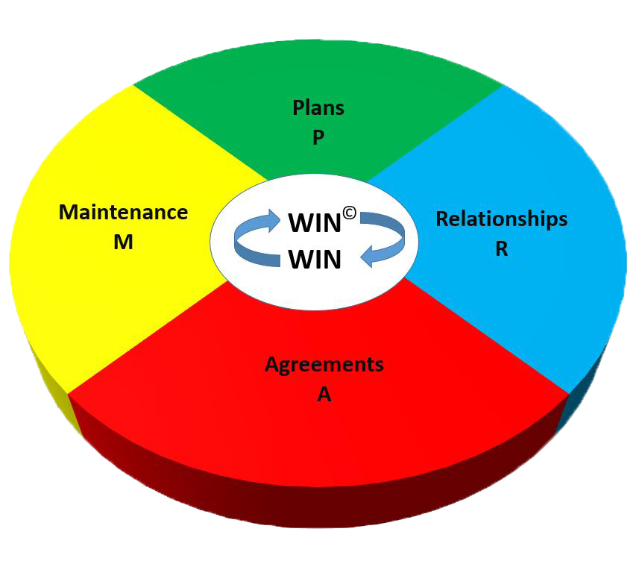
PRAM
MODEL

Slide 10
Details
of the Win-Win
Negotiation Process

Slide 11
STEP 1: ESTABLISH A WIN-WIN PLAN

Slide 12
Determine Your Self-Interest
What’s
Why’s

Slide 13
Identify The People Who Stand Between You and Success or Failure

Slide 14
Determine Their Self-Interest
What’s
Why’s

Slide 15
Develop a Plan to Connect the Two Sets of Self-Interests
What can I do for the other party that will motivate them to give me what I want in return?

Slide 16
PLAN QUESTIONS TO OPEN
YOUR DISCUSSION
Questions which nail down facts
Questions which verify your assumptions
about the other party’s self-interest
Questions which allow the other party
to talk so you can listen

Slide 17
STEP 2: DEVELOPING WIN-WIN RELATONSHIPS

Slide 18
Plan Situations Which Allow Relationships to Develop
_________________________________
_________________________________
_________________________________
_________________________________

Slide 19
BEHAVIORAL CONSIDERATIONS
FOR BUILDING RELATIONSHIPS
• Become genuinely interested in the people you deal with
• Talk in terms of the other party’s interests rather than your own
• Be a good listener and encourage others to talk about themselves
Source: How To Win Friends and Influence People, by Dale Carnegie

Slide 20
KEY BEHAVIORAL ACTIVITIES
FOR BUILDING RELATIONSHIPS
Ask questions
Listen
Summarize
Feedback

Slide 21
CULTIVATING
A WIN-WIN RELATIONSHIP
The three phases of relationship development
LIKING
BONDING
TRUSTING

Slide 22
CULTIVATING
A WIN-WIN RELATIONSHIP (Cont.)
LIKING
BONDING
TRUSTING
Liking is having positive thoughts or feelings about the other party

Slide 23
CULTIVATING
A WIN-WIN RELATIONSHIP (Cont.)
LIKING
BONDING
TRUSTING
Bonding is the discovery of common interests and experience with the other party

Slide 24
CULTIVATING
A WIN-WIN RELATIONSHIP (Cont.)
LIKING
BONDING
TRUSTING
Trusting occurs when both parties demonstrate a genuine willingness to understand and respect the interests and desires of the other party

Slide 25
CULTIVATING
A WIN-WIN RELATIONSHIP (Cont.)
SOCIALIZING
LIKING
BONDING
TRUSTING
Socializing involves participating in casual conversation with the other party

Slide 26
CULTIVATING
A WIN-WIN RELATIONSHIP (Cont.)
SOCIALIZING
LIKING
BONDING
TRUSTING
REFERENCES
References are statements of qualifications from a mutual acquaintance

Slide 27
CULTIVATING
A WIN-WIN RELATIONSHIP (Cont.)
SOCIALIZING
LIKING
BONDING
TRUSTING
REFERENCES
The relationship development process

Slide 28
Don’t Get Down to Business too Quickly
The other party may question your motives
Attempting to rush the relationship will only impede the development of trust

Slide 29
STEP 3: FORMING WIN-WIN AGREEMENTS

Slide 30
OPEN THE DISCUSSION WITH
QUESTIONS
Questions which nail down facts
Questions which verify your assumptions
about the other party’s self-interest
Questions which allow the other party
to talk so you can listen

Slide 31
IMPLEMENT YOUR WIN-WIN PLAN
Key Strategy: Talk to the other party about what they want first (their win) and then show them how to get it (your win)
Be flexible and sensitive toward the other party

Slide 32
JOINTLY RESOLVE DIFFERENCES
Basic Considerations:
• Separate people from problems
• Try to see things from the other party’s point of view
• Listen and let the other party do much of the talking
• Never try to convince someone they are wrong
Always be on the lookout for ways to expand the pie

Slide 33
FINALIZE THE AGREEMENT
Make sure both parties understand what they’ve agreed to and feel good about the agreement
Develop a plan to resolve potential problems
Put the agreement in writing if necessary

Slide 34
STEP 4: PERFORMING WIN-WIN MAINTENANCE

Slide 35
MAINTAIN THE AGREEMENT
• Work to prevent “buyer’s remorse”
• Exceed expectations
• Provide meaningful feedback to the other party based on performance

Slide 36
MAINTAIN THE RELATIONSHIP
• Keep the relationship close
• Take advantage of opportunities to reaffirm trust

Slide 37
MAINTAIN THE PLAN
• Develop a system of reminders that works for you
• Examples:
______________________________________
______________________________________
______________________________________
______________________________________
______________________________________

Slide 38
PUTTING THE PRAM MODEL TO WORK

Slide 39
USING THE PRAM MODEL AS A DIAGNOSTIC
AND PROBLEM SOLVING TOOL
Common Negotiation Problems
• New people
• People who are irate or upset
People in power positions
Difficult people

Slide 40
PRAM
MODEL

Slide 41
KEYS TO MAKING THE WIN-WIN NEGOTIATION PROCESS WORK
Balance
Integrity
Patience

