Slide 1
TURNING YOUR CUSTOMRS
INTO LONG-TERM FRIENDS
THE SECRET SAUCE THAT
GUARANTEES REPEAT AND
REFERRAL SALES
ROSS R. RECK, PhD
www.rossreck.com
602-391-3250

Slide 2
REPEAT AND REFERRAL SALES BASICS
Selling is all about people
People are motivated by self-interest
The entire selling process must be Win-Win
You must use a selling model the guarantees repeat and referral sales

Slide 3
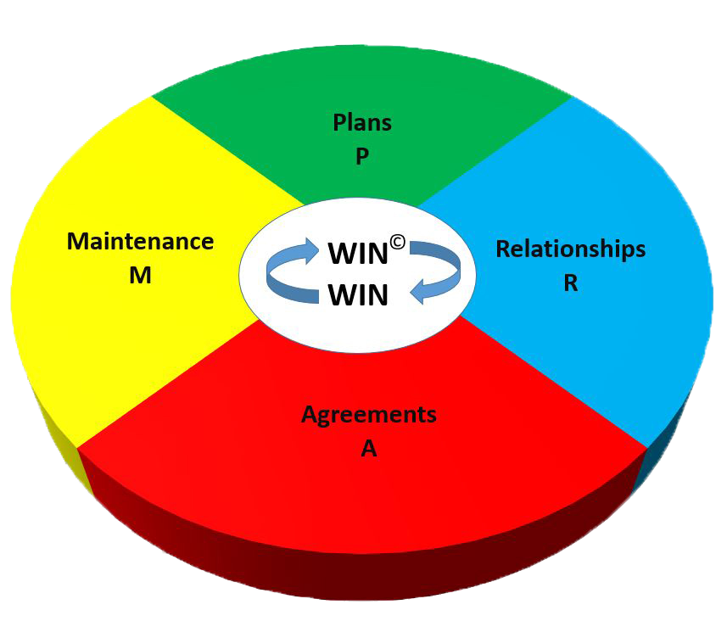
PRAM
MODEL

Slide 4
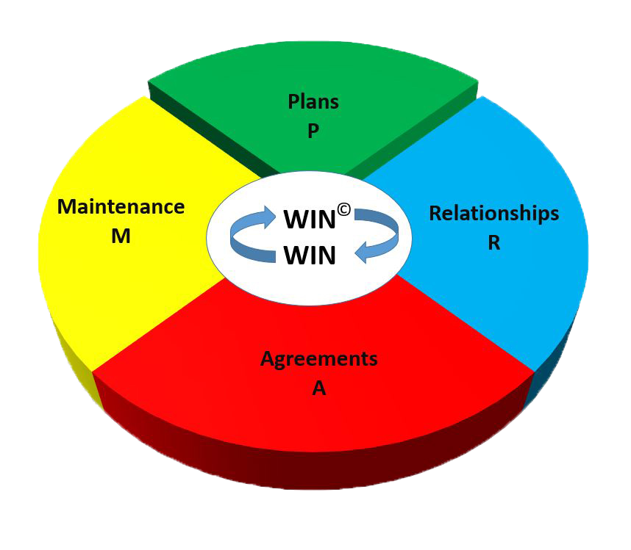
WIN-WIN PLANS

Slide 5
WIN-WIN PLANS
Determine your self-interest
Identify the people who stand between you and success or failure
Determine the customer’s self-interest
Develop a strategy to connect the customer’s self-interest with yours

Slide 6
Determine Your Self-Interest
Your self-interest needs to include three things:
Getting your customer to buy
Getting your customer to keep buying
Getting your customers to sell

Slide 7
Identify the People Who Stand Between You and Success or Failure
Decision makers
Influencers
Stakeholders
Gatekeepers

Slide 8
Determine the Customer’s Self-Interest
The key is listening
Listening involves the following:
Ask questions
Listen to the customer’s responses
Summarize (in your mind) what was said
Feed this summary back to the customer
Ask follow-up questions and repeat the process

Slide 9
Develop a Strategy to Connect the Customer’s Self-Interest with Yours
Talk to the customer about what he or she wants first (that’s their Win)
Then show the customer what he or she need to give you in return to get their Win (that’s your Win)

Slide 10
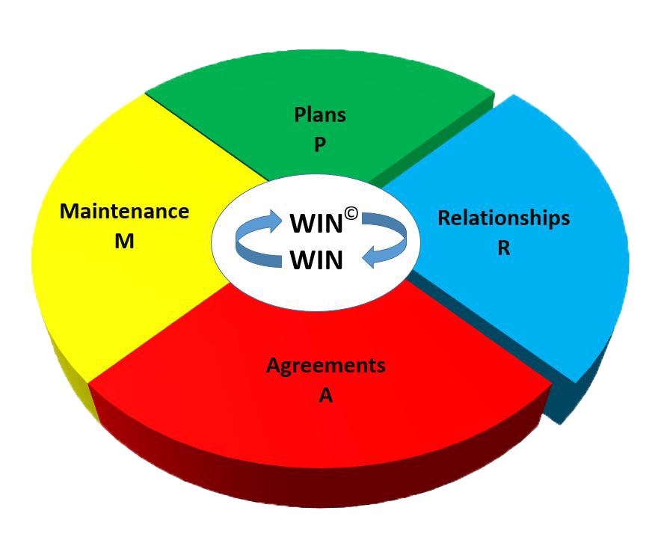
WIN-WIN RELATIONSHIPS

Slide 11
WIN-WIN RELATIONSHIPS
Plan situations that allow a relationship to develop
Cultivate the relationship
Don’t get down to business too quickly

Slide 12
Plan Situations that Allow a Relationship to Develop
Lunch
Coffee
Informal visits
Coach a Little League or soccer team
Get active in the PTA or your HOA
Industry meetings or professional assoc.

Slide 13
Cultivate the Relationship
The key is to focus on them:
Become genuinely interested in your customers
Be a good listener and encourage your customers to talk about themselves
Try to see things from the customer’s point of view
Remember, you’re there for them

Slide 14
Don’t Get Down to Business too Quickly
If you do the customer will:
Question your motives
Decide he or she can’t trust you
Look to do business with someone else

Slide 15
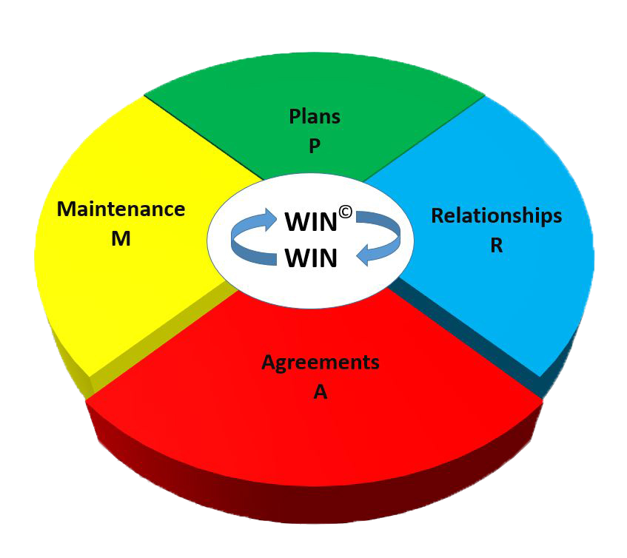
WIN-WIN AGREEMENTS

Slide 16
WIN-WIN AGREEMENTS
Verify the customer’s self-interest
Implement your strategy to connect the customer’s self-interest with yours
Work together to resolve problems
Finalize the agreement

Slide 17
Verify the Customer’s Self-Interest
The key is listening
Listening involves the following:
Ask questions
Listen to the customer’s responses
Summarize (in your mind) what was said
Feed this summary back to the customer
Ask follow-up questions and repeat the process

Slide 18
Implement Your Strategy to Connect the Customer’s Self-Interest with Yours
Talk to the customer about what he or she wants first (that’s their Win)
Then show the customer what he or she needs to give you in return to get their Win (that’s your Win)

Slide 19
Work Together to Resolve any Problems
Dealing with customer “objections”
Once again the key is listening
Hear the customer out completely
Work together as friends to come up with a solution that satisfies you both

Slide 20
Finalize the Agreement
Clear up any misunderstandings
Make sure both you and the customer are excited about the agreement
Put a system in place to resolve potential problems

Slide 21
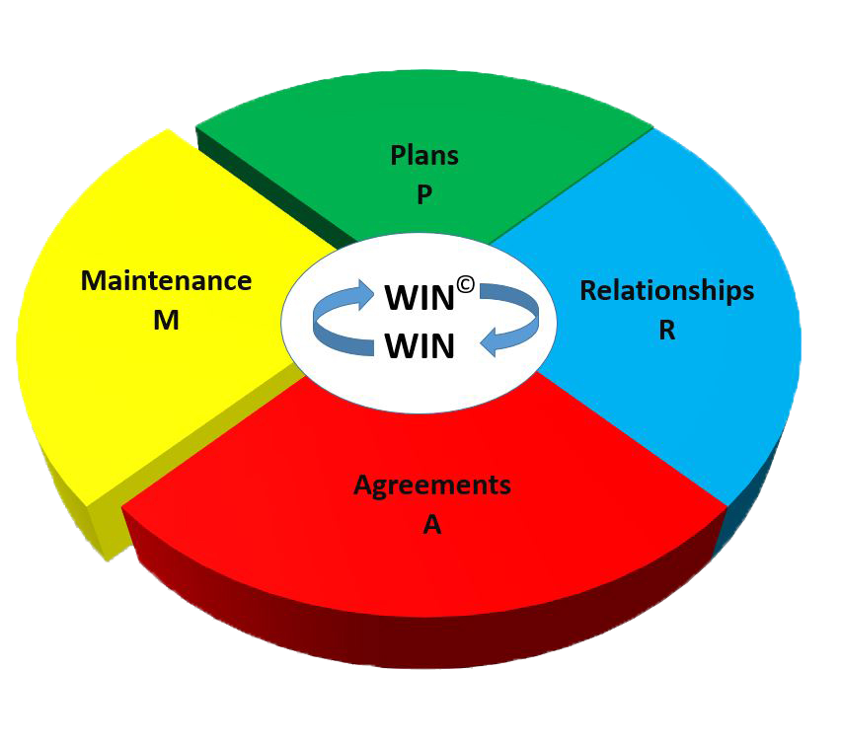
WIN-WIN MAINTENANCE

Slide 22
WIN-WIN MAINTENANCE
Maintain the Agreement
Maintain the Relationship
Maintain the Plan

Slide 23
Maintain the Agreement
Work to prevent “buyer’s remorse”
Hold up your end of the Agreement
Provide meaningful expressions of appreciation to customers who go the extra mile for you

Slide 24
Maintain Your Relationships
Spend time visiting with customers when you don’t ask for anything
If you find a problem—fix it—even if it’s not your problem

Slide 25
Maintain Your Plans
Develop a system of reminders that works for you
Examples:
________________________________
________________________________
________________________________
________________________________

Slide 26
USING THE PRAM MODEL AS A DIAGNOSTIC AND PROBLEM SOLVING TOOL

Slide 27
COMMON SELLING PROBLEMS
Cold calls
Objections
Irate or dissatisfied customers
People who are in power positions
Difficult people

Slide 28
PRAM
MODEL

Slide 29
KEYS TO MAKING THE PRAM MODEL WORK
FOR YOU
Balance
Integrity
Patience

