Slide 1
100 % EMPLOYEE ENGAGEMENT—GUARANTEED! Presented By ROSS RECK, PhD
rossreck.com

Slide 2
BUSINESS LEADERS WANT A HIGH LEVEL OF EMPLOYEE ENGAGEMENT

Slide 3
EMPLOYEE ENGAGEMENT IS THE PRIMARY DRIVER OF:
Profitability
Productivity
Innovation
Employee Loyalty
Customer Loyalty
Stock price

Slide 4
COMPANIES WITH A HIGH LEVEL OF EMPLOYEE ENGAGEMENT:
Outperform companies with a low level of employee engagement
Enjoy substantial cost savings due to reduced employee:
turnover
absenteeism
accidents
theft
Are magnets for attracting the best talent

Slide 5
EMPLOYEES ALSO WANT A HIGH LEVEL OF EMPLOYEE ENGAGEMENT

Slide 6
ENGAGED EMPLOYEES:
Love what they do
Have an emotional attachment to their work
Come to work every day excited about giving every bit of their energy, creativity and passion to performing their job

Slide 7
WHY ISN’T EMPLOYEE ENGAGEMENT HAPPENING ON A LARGE SCALE?

Slide 8
EMPLOYEE ENGAGEMENT IS ALL ABOUT MOTIVATION
Keys to Understanding Human Motivation
Human beings are motivated by self-interest
Human beings are perpetually wanting animals
Human needs are arranged in a hierarchy of importance

Slide 9
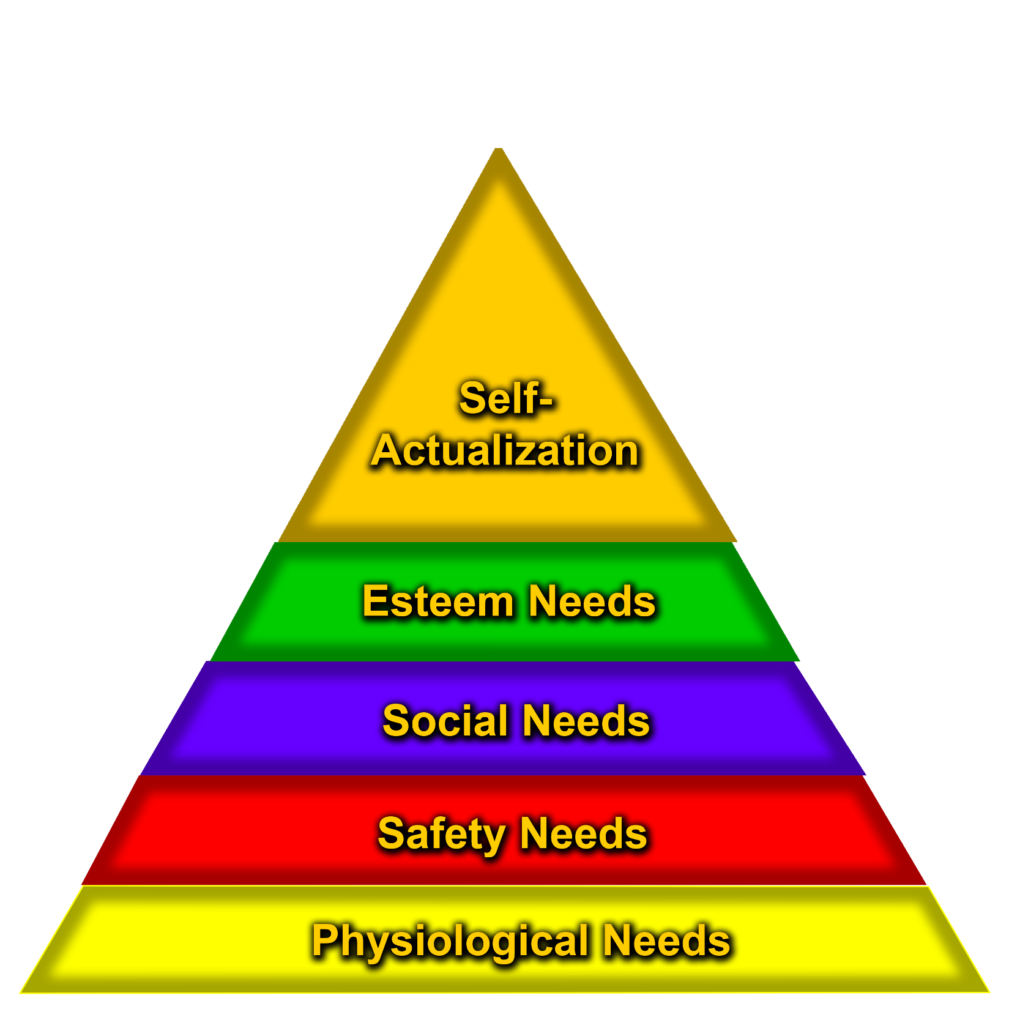

Slide 11
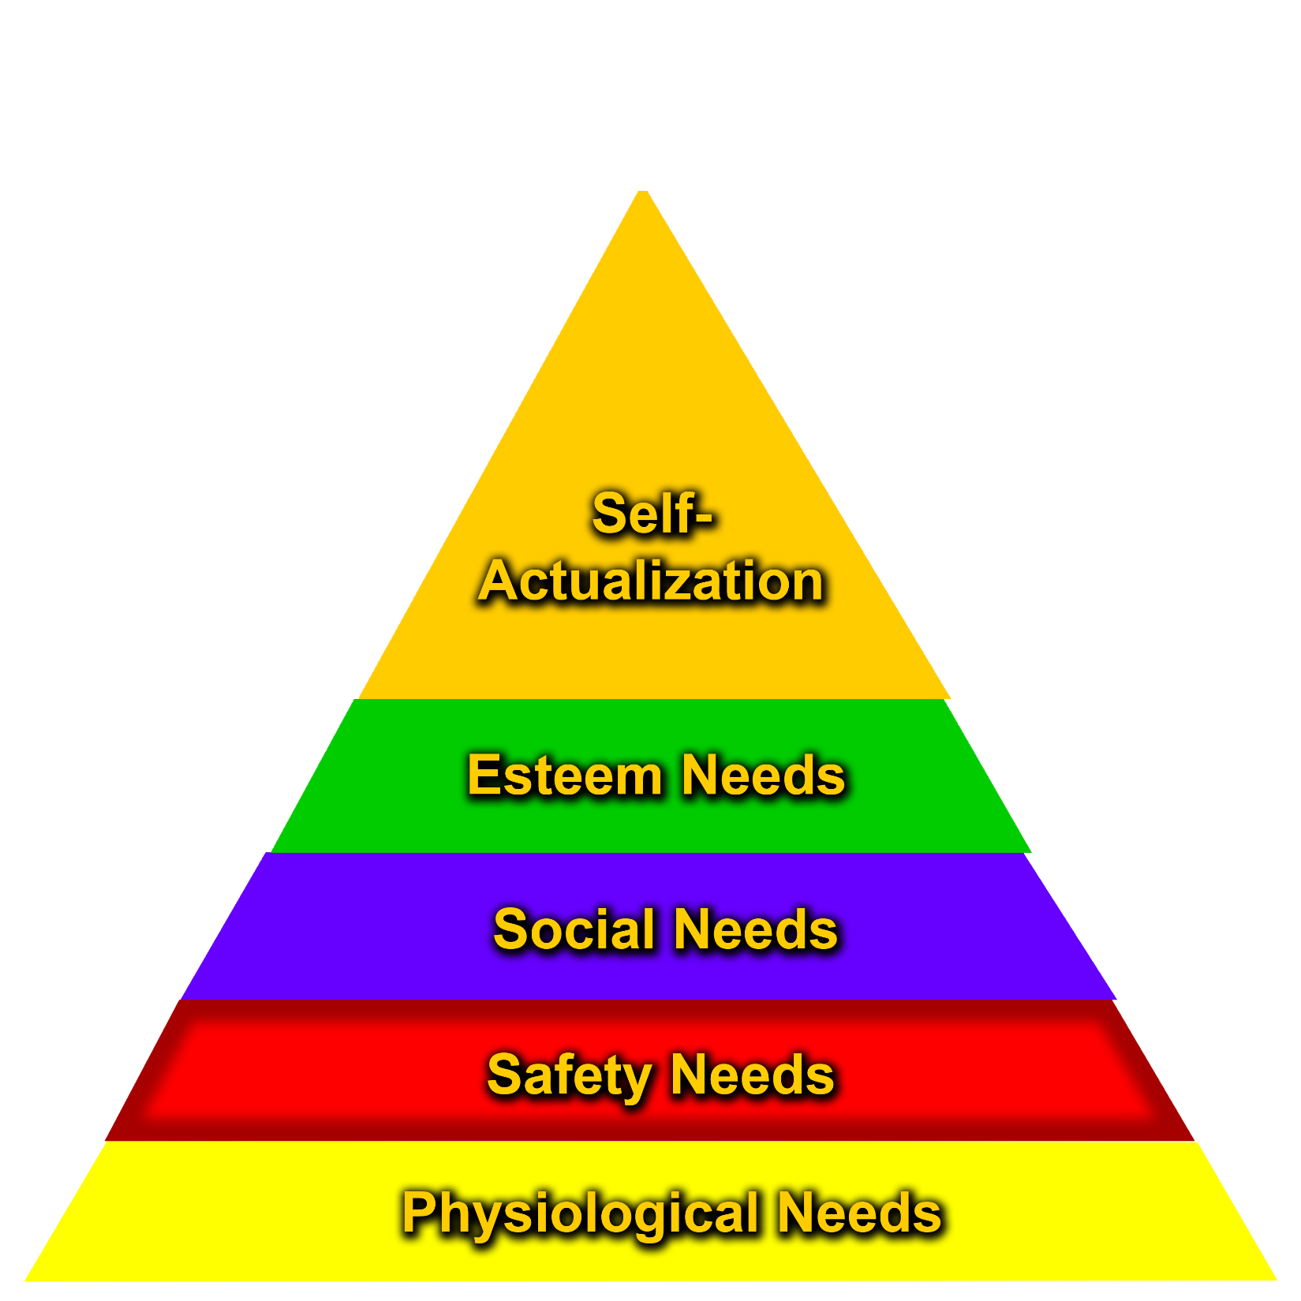

Slide 13
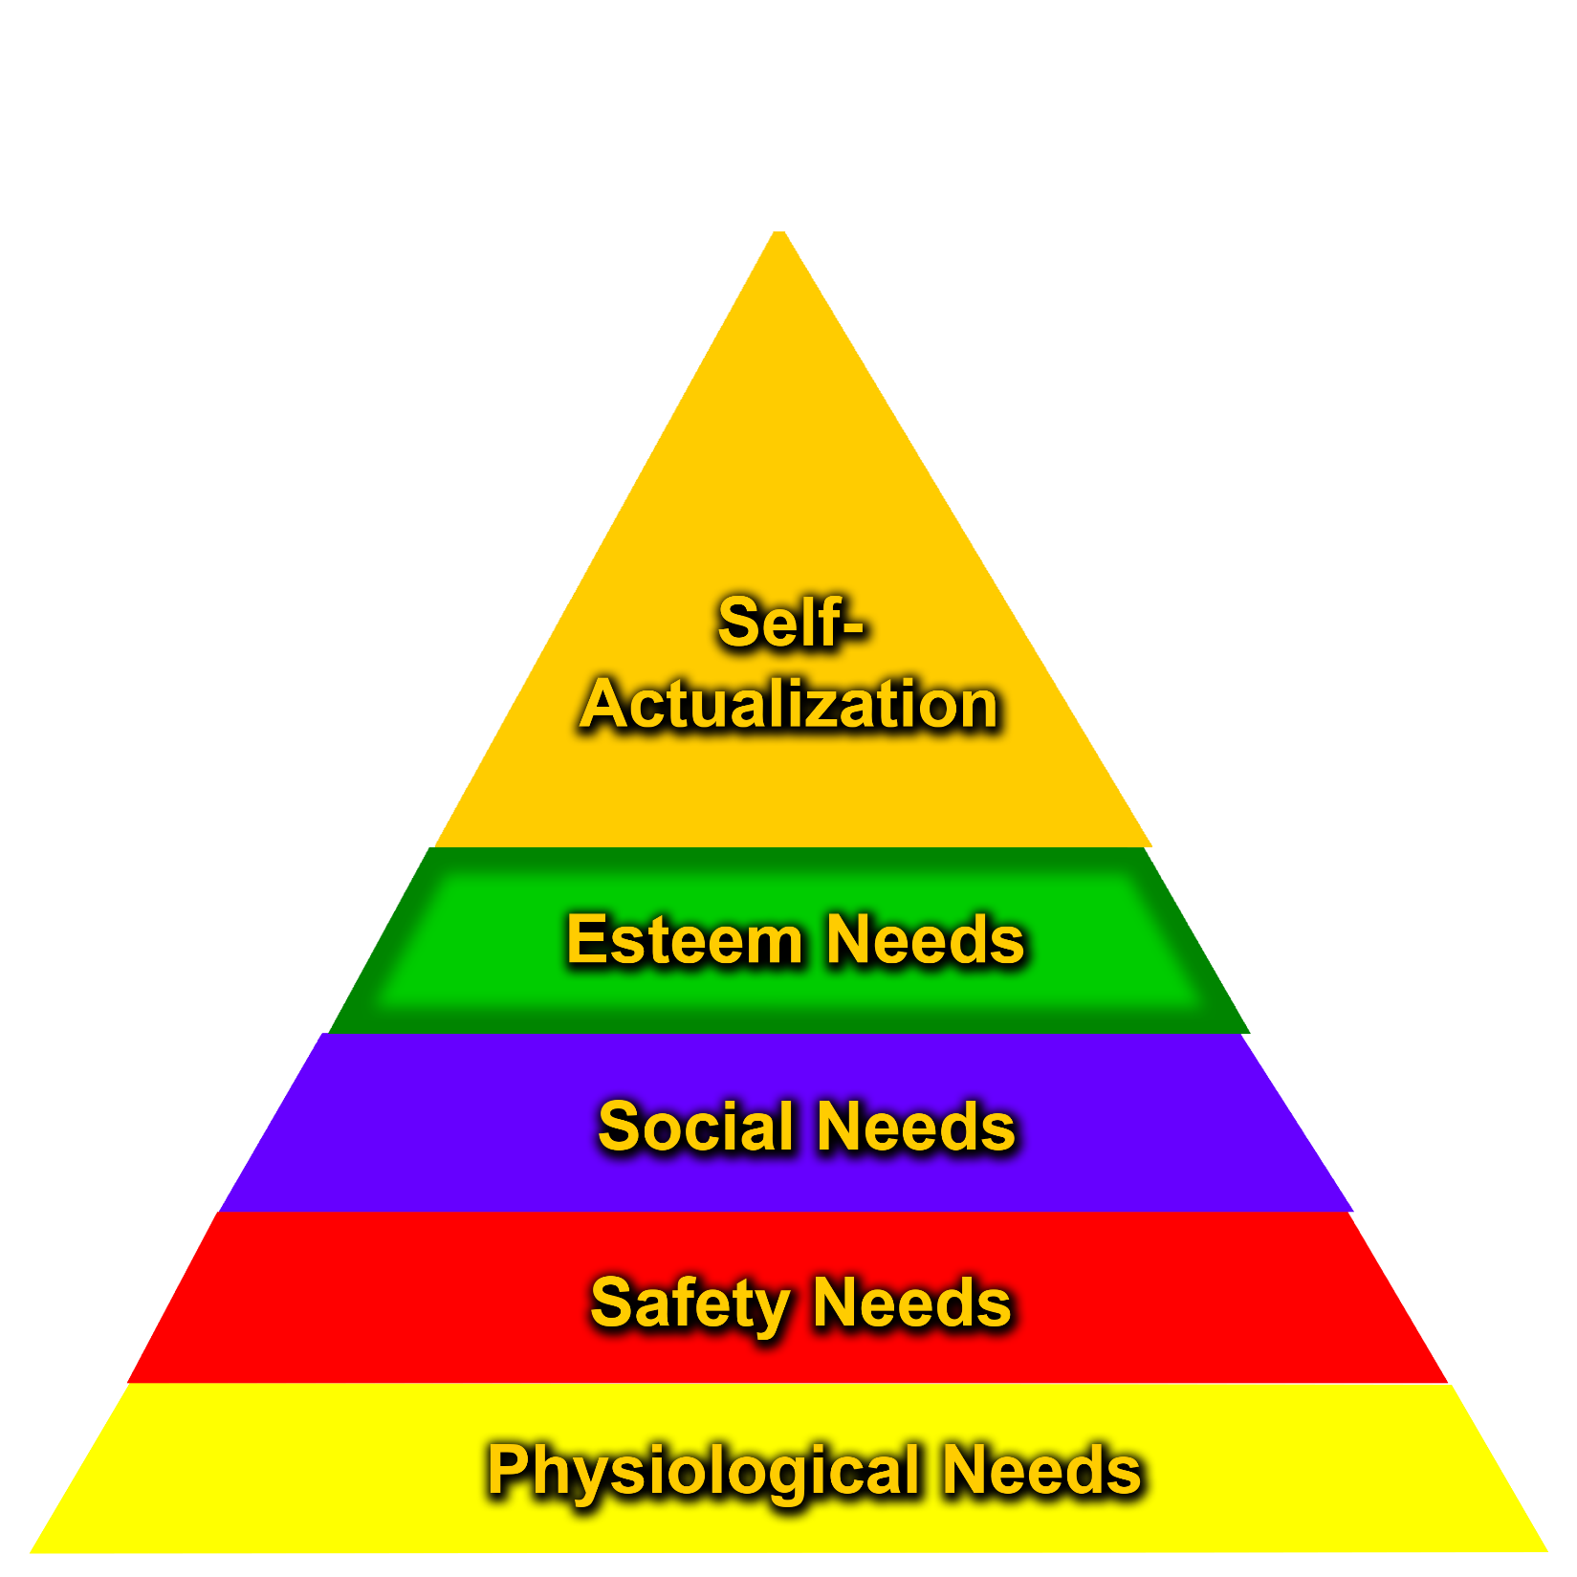

Slide 14
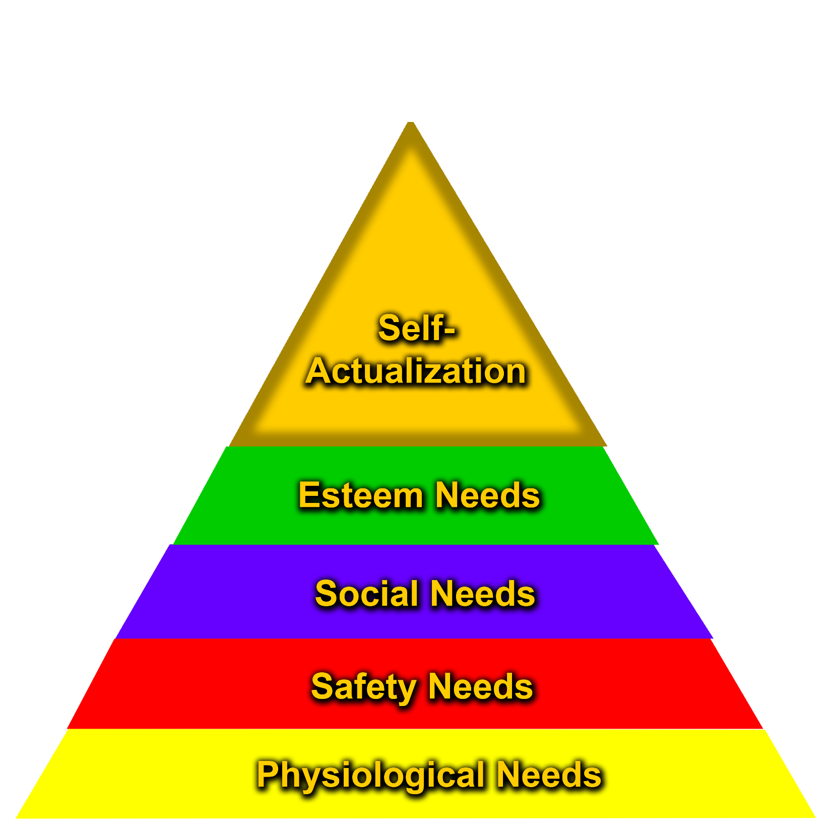

Slide 15
CONCLUSIONS ABOUT HUMAN MOTIVATION
It’s Impossible to motivate people at work
Self-Actualization and Employee Engagement are the same thing
Employees want to be engaged with their work

Slide 16
THE TRADITIONAL MANAGEMENT MODEL
Management decides upon and communicates performance expectations to employees
Management monitors actual performance to see how it compares to expectations
Management provides feedback on performance supported by rewards and punishment

Slide 17
WHY DOES THE TRADITIONAL MANAGEMENT MODEL PREVENT EMPLOYEES FROM BECOMING ENGAGED WITH THEIR WORK?
It places managers in a position of dominance over the people they are managing

Slide 18
CONCLUSION
It’s impossible to create a fully engaged workforce using the Traditional Management Model

Slide 19
WE NEED TO CREATE A NEW MODEL
A model that causes employees to become engaged with their work

Slide 20
SOUTHWEST AIRLINES
It has made a profit every year since 1973
Its workforce is the most loyal and productive in the industry
It’s consistently rated at or near the top when it comes to customer service

Slide 21
SOUTHWEST AIRLINES’ CULTURE
Southwest takes excellent care of its employees
At Southwest, all employees are treated as “family members”
At Southwest employees are encouraged to be themselves and have fun
Southwest employees are proud of their company and strongly believe in what it stands for

Slide 22
WHAT HAS SOUTHWEST SUCCEEDED IN DOING?

Slide 23
THE ENGAGEMENT FORMULA
A new management model that guarantees an employee engagement level of 100%

Slide 24
STEP ONE: CREATE A FULL-ENGAGEMENT CULTURE THAT DEFINES THE ORGANIZATION AND DRIVES PERFORMANCE
Elements of a Full-Engagement Culture:
Minimal Distractions—So Employees Can Focus on Doing Their Best Work
Single Status—Everyone is an equal
Mission—This is what we do
Core Values—This is how we do it

Slide 25
Minimal Distractions—So Employees Can Focus on Doing Their Best Work
Compensation packages that are at or above industry average
Fairly generous benefits
Reasonably secure job
Pleasant and safe work environment

Slide 26
Single Status—Everyone is an Equal
Everyone has the same level of influence
All symbols and terms of unequal status have been done away with
The term used to refer to fellow employees reflects equal status
“Googlers”
“Associates”
“Family members”
“Cast members”

Slide 27
Mission—This is What We Do
Zappos: “Provide the Best Customer Service Possible
W.L. Gore & Associates: “To Make Money and Have Fun Doing So
JetBlue: “To Bring Humanity Back to Air Travel

Slide 28
Core Values—This is How We Do It (Zappos)
Deliver WOW Through Service
Create Fun and A Little Weirdness
Be Humble

Slide 29
Core Values Represent Behavioral Expectations for Employees
Within their context, employees are free to exercise their autonomy over their work
When a mission and a set of core values is in place, employees no longer need a boss

Slide 30
HAVING A FULL-ENGAGEMENT CULTURE, BY ITSELF, IS NO GUARANTEE OF SUCCESS
You still have to hire the right people

Slide 31
STEP TWO: HIRE ONLY QUALIFIED PEOPLE WHO MESH WITH THE CULTURE
High-engagement companies are extremely disciplined in their hiring practices—they don’t settle
Their culture is the primary criterion used for hiring new employees
High-engagement companies use a two part interview process
“Bar Raisers” at Amazon.com
The goal is to avoid hiring “cultural Misfits”

Slide 32
Support the hiring effort with a relevant training and/or sponsorship program that teaches and reinforces the culture
High-engagement companies don’t expect new employees to learn and live the culture on their own
W. L. Gore & Associates
Southwest Airlines
Zappos

Slide 33
STEP THREE: LEADERS MUST LEAD, NOT GIVE ORDERS
Leaders Set the Example
Leaders Provide Support
Leaders Make Sure the Culture Stays Healthy

Slide 34
SUCCESSFUL COMPANIES WHOSE LEADERSHIP PRACTICES EMBRACE THE ENGAGEMENT FORMULA
Google
W. L. Gore & Associates
SAS
Southwest Airlines
Frank Myers Auto Maxx

Slide 35
OTHER SUCCESSFUL COMPANIES WHOSE LEADERSHIP PRACTICES EMBRACE THE ENGAGEMENT FORMULA
Quicken Loans
USAA
FedEx Express
Marriott International
Wegmans Food Markets
QuikTrip

Slide 36
THE PAYOFF FOR IMPLEMENTING THE ENGAGEMENT FORMULA
Incredible Levels of Profitability, Productivity, Customer Loyalty and Employee Loyalty
Extraordinary Success at Delivering “WOW” Customer Service
Exceptional Levels of Creativity and Innovation
Your business becomes a magnet for attracting the best talent

Slide 37
CONCLUSIONS
The Engagement Formula is not some futuristic notion that just might catch on some day
It’s already happening and in a big way
All companies that embrace The Engagement Formula are doing extremely well
If you choose to ignore The Engagement Formula, your company could get left in the dust

Slide 38
CREATING A FULLY-ENGAGED WORKFORCE IS THE BEST BUSINESS MOVE ON THE PLANET
It costs next to nothing
Takes organizational performance to incredible levels
Everybody wins
Your company becomes the one that leaves your competitors in the dust

